Slide 1

Waste classification model using machine learning
Submitted by:- AMAN KAUSHIK
University roll no.:- 2018662
BTECH(CSE)
SEC - C
MENTOR – Dr. Guru prasad M S

Slide 2
INTRODUCTION
The project focuses on the development of a robust waste classification model using advanced machine learning techniques, specifically leveraging the VGG16 convolutional neural network architecture. Aimed at addressing the increasing challenges in waste management, the model distinguishes between organic and recycled waste based on images.
The dataset comprises images of waste items, categorized as organic or recycled. Initial data preprocessing involves techniques like filling missing values and exploring statistical measures. Exploratory data analysis is performed to gain insights into the distribution of attributes, and visualization tools such as scatter plots, histograms, and violin plots are utilized.

Slide 3
The methodology involves the utilization of the VGG16 model, a powerful convolutional neural network known for image classification tasks. The model is pretrained on a large dataset and excludes the top layers, enabling feature extraction for our specific waste classification task. Further, the project employs data augmentation techniques during the training process to enhance the model's ability to generalize.
Results and discussions encompass the evaluation of the model's performance through metrics like loss and AUC-ROC, providing insights into its accuracy and discriminatory power. The study concludes with implications for waste management systems, emphasizing the potential for automated waste sorting using image-based classification models. Future work may involve scalability, real-time implementation, and integration into waste management infrastructure for enhanced sustainability practices.

Slide 4
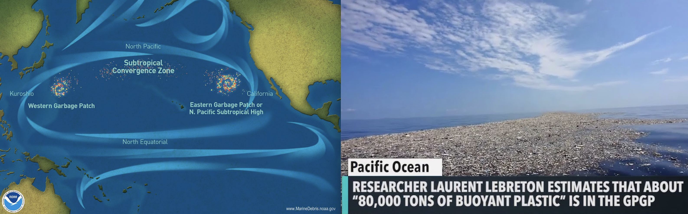
PROBLEM STATEMENT
The waste classification project addresses the challenge of effectively categorizing waste into organic and recyclable materials using advanced machine learning techniques. The problem lies in automating waste sorting to enhance recycling processes. Traditional sorting methods are labor-intensive and often inaccurate. This project aims to develop a robust waste classification model that can analyze images of waste items, distinguishing between organic and recyclable materials, contributing to more efficient and sustainable waste management practices.

Slide 5
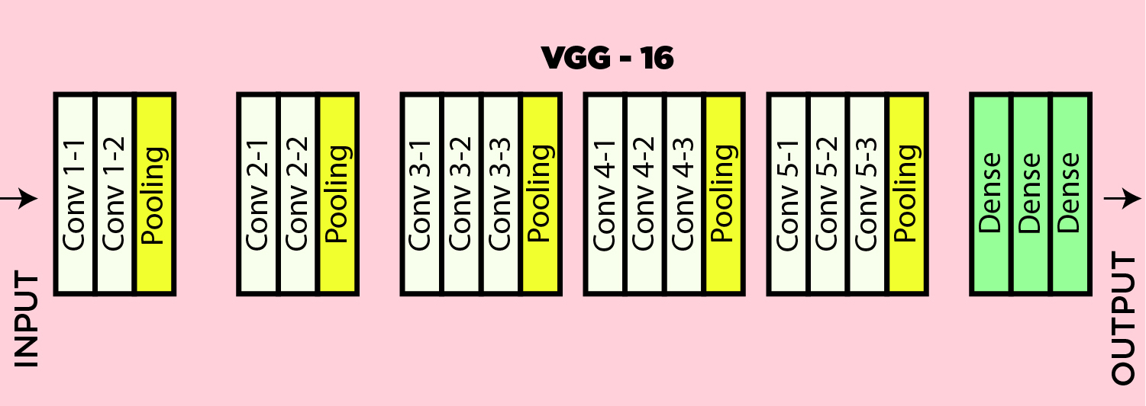
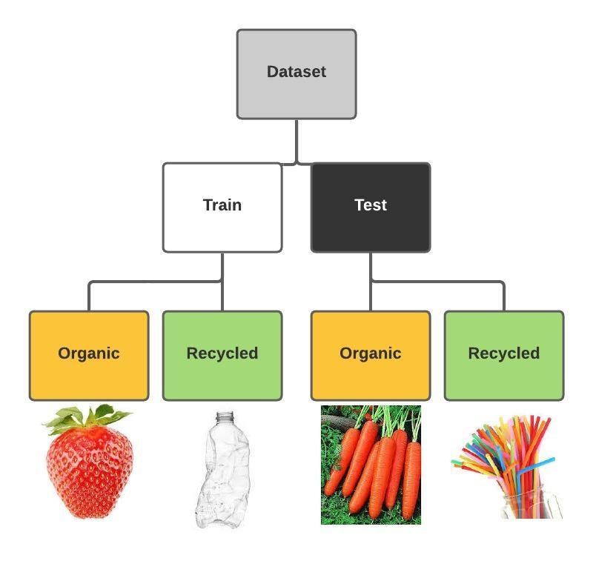
METHODOLOGY
Vgg16:
VGG16, employed in the project, is a renowned deep learning architecture that excels in image recognition tasks. With a structure featuring 16 layers, including convolutional and pooling layers, it has proven effective in extracting intricate features from images. Trained on large datasets, VGG16 can discern patterns and complexities in visual data. By excluding the top layer, the model serves as a feature extractor, allowing the addition of custom layers for specific tasks, such as waste classification, leveraging its pre-learned hierarchical features for enhanced performance.

Slide 6
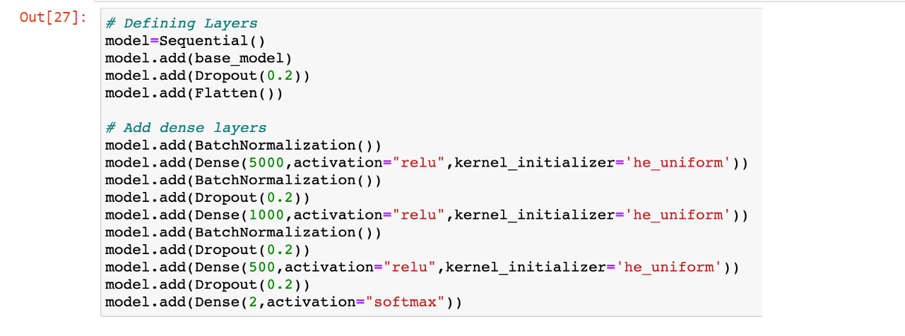
Sequentail model:
The sequential model in the project is the backbone for building a neural network. It enables the systematic construction of layers in a linear stack. In this implementation, the sequential model incorporates the VGG16 architecture, followed by additional layers like dropout, flatten, batch normalization, and dense layers. This arrangement facilitates the creation of a comprehensive deep learning model for waste classification, with each layer contributing to feature extraction, normalization, and classification, ultimately enhancing the model's ability to discern between organic and recycled waste.

Slide 7
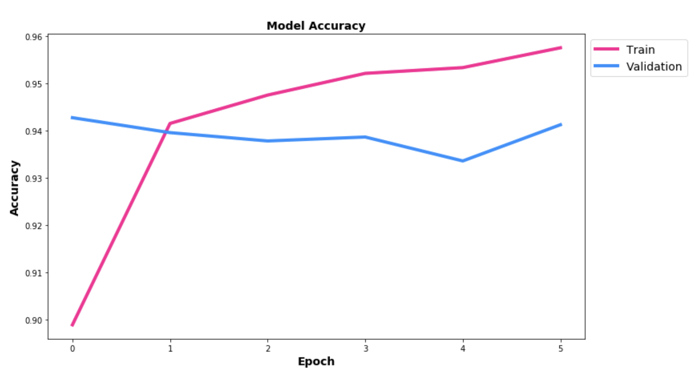
IMPLEMENTATION AND RESULTS:
IN this model I have not only consider accuracy of the model testing but also consider some other precisions
recall and f1-score and then check this using confusion matrix.

Slide 8
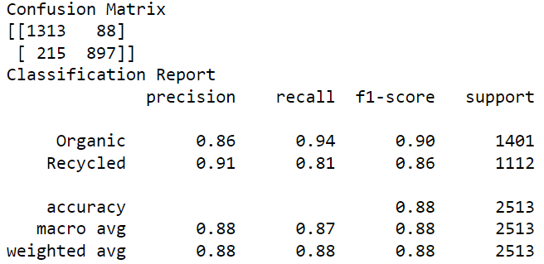
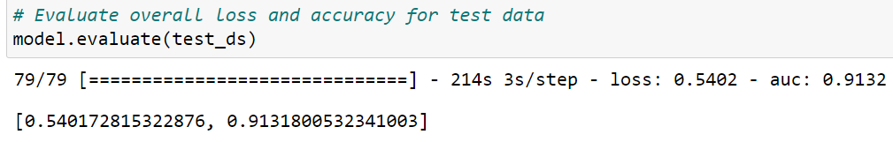
confusion matrix for tn ,fp,fn,tp
test dataset accuracy

Slide 9
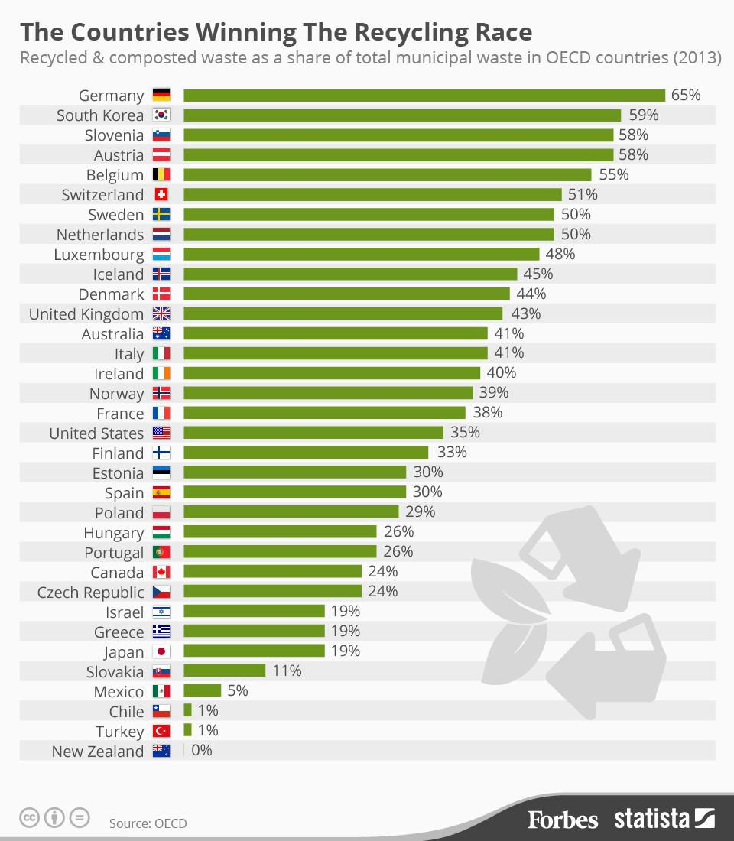
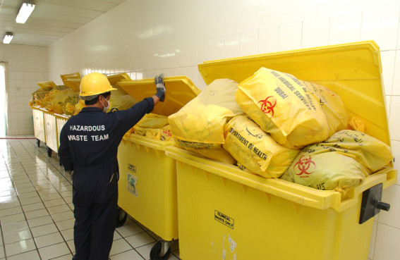
CONCLUSION
The model is able to classify the objects into recyclable or organic.

